Slide 1

NATIONAL INSTITUTE OF TECHNOLOGY AGARTALA
DEPARTMENT OF MECHANICAL ENGINEERING
INCA WHISTLE
Under the guidance of DR. ANKURAN SAHA.
Presented by Satish Kumar 21UME004 Tushar Deb 21UME003

Slide 2
Table of Contents
Page
I
Abstract
3
II Introduction
4
III
About Trema Orientalis
7-8
IV Fibre extraction
9-12
V
Composite formation
13-19
VI
Testing and testing resultt
20-31
VII Scope of future improvement
32-33

Slide 3
Abstract
Clay, along with humanity’s existence has been used as the most primitive material in making all kinds of goods to meet daily needs. One of these daily use objects is the toy that carries great importance as tool of entertainment, communications and development. The human instinct to explore and play has been shaped in various ways with the clay in different civilizations. Terracotta has become the basic material of the different toys as the main tool of act of playing. Ceramic whistles, widely seen from Prehistoric times to the present day from Europe to Asia, America, pre-Columbian cultures, also appeared in various civilizations as a type of whistling instrument as the ritual objects used in ceremonies. In this sense, ceramic whistles began to lose attention, especially in Turkey started to disappear with missing values due to diversity, changes and the development of toys within the industrial revolution. They are being produced as nostalgic toys, souvenir objects with limited edition. In this study, reference to the history of ceramic whistles, the arrival of the present day is being explained, as handicraft production, particularly by means of traditional aspect.

Slide 4
Introduction
The subject of this research is the type of wind whistles referred to as a terracotta / Inca whistle, being the most primitive musical instrument and variety of toy, which was given shape with clay as a material and had special names in various countries and regions. Inca vessel based on pentatonic scale with instrument such a quena (i.e., type of flute), panpikes being commonly use. Inca also used natural sound such as chirping of birds and the sound of wind to create music.

Slide 5
OI
bjectives
We will do later on…..
5

Slide 6
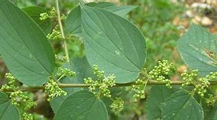
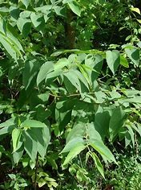
Parameters
We will do later on….

Slide 7
How sound is Generated?
We will do later on….

Slide 8
Simulation of Inca Whistle
We will do later on…..

Slide 9
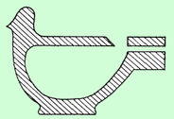
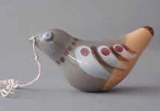
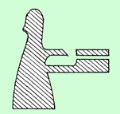

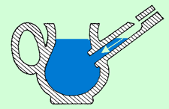
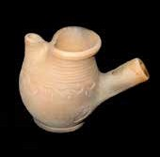
Classification of Whistles
1) Globular Whistles : It is enclosed as form and their bodies have a globular inner cavity. The sound is created by the mouthpiece located on the edge. Their sound intensity is weak.
2) Tubular Whistles : Its tonality depends on the length of the pipe in this whistle type, where blowing form is connected to the base or body from outside. While tubular whistles have high-pitched sound whereas the globular whistles have deeper and softer sound. If it has a pedestal and a base, it may be tubular.
3) Water Whistles : These are called nightingale, botijito pitchers in various languages. It is a combination of globular whistles and tubular whistles. The difference is that the air blown through the pipe hits the water rather than the wall by filling water into the cavity, and the water level raises and creates sound.
Figure : Globular Whistle Section
Figure: Globular Whistle Sample
Figure : Tubular Whistle Section
Figure: Tubular Whistle Sample
Figure : Water Whistle Section
Figure: Water Whistle Sample / Ezgi Martinez Collection

Slide 10
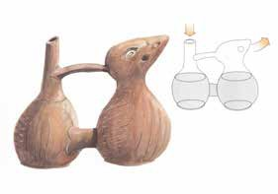
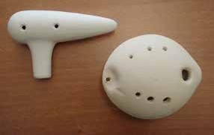
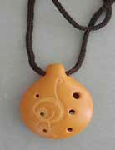
4) Multi-chambered Water Whistles : The types of these special forms commonly encountered in a geography extending from Mexico to Peru since one, two thousand years ago until now, go up to 6 chambers. The types with double chamber are the most common ones. These are jointed from the bottom and connected with a handle from the top. The sound is created by the air coming out of upper chamber of a small hole.
5) Ocarina : It is known that ocarina, derived from the word oca meaning “Little Goose”, invented by Ita- lian Guiseppe Luigi DONATI in 1860. It was encountered in ancient Egypt, Mexico civilizations but was not referred with this name until the said date. This type of instruments is also found among the porcelain product of German Meissen Company (Kura, 2004, 334). It is known that as well as being shaped as handmade or with moulds, they are also produced in different sizes.
Figure 13: Multi-chambered Water Whistle (Abrashev, 2000,p. 41)
Figure : Ocarinas by Alp Çam
Figure: Ocarina by Sergio Garcia,Chili Collection of Prof.Sevim Çizer

Slide 11
Uses of Inca Whistle
They used these vessel for journey to other realms as well as helping to improve health a well being.
These vessel are usually made in the shape of animals, peoples or mythical figure.
These whistling bottle was likely used for rituals, religious and secular as a form of entertainment.
The production of binomial frequencies have also been known to induce meditation, help with pain management, improve sleep and reduce stress.

Slide 12
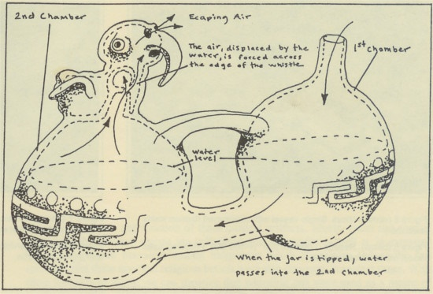
Mechanism
The mechanism that creates the sound is a hollow ball with a circular hole that was a sharp edge. The sharp edge with the air i.e., blown into the mechanism which vibrates the air & produces the sound frequency. This air can be blown to the lengs or depending on the vessel and culture, with water being moved from one container if the vessel to another. These vessels can have a single sound mechanism on many of those two.
12

Slide 13
Technology
We will do later on…
9

Slide 14
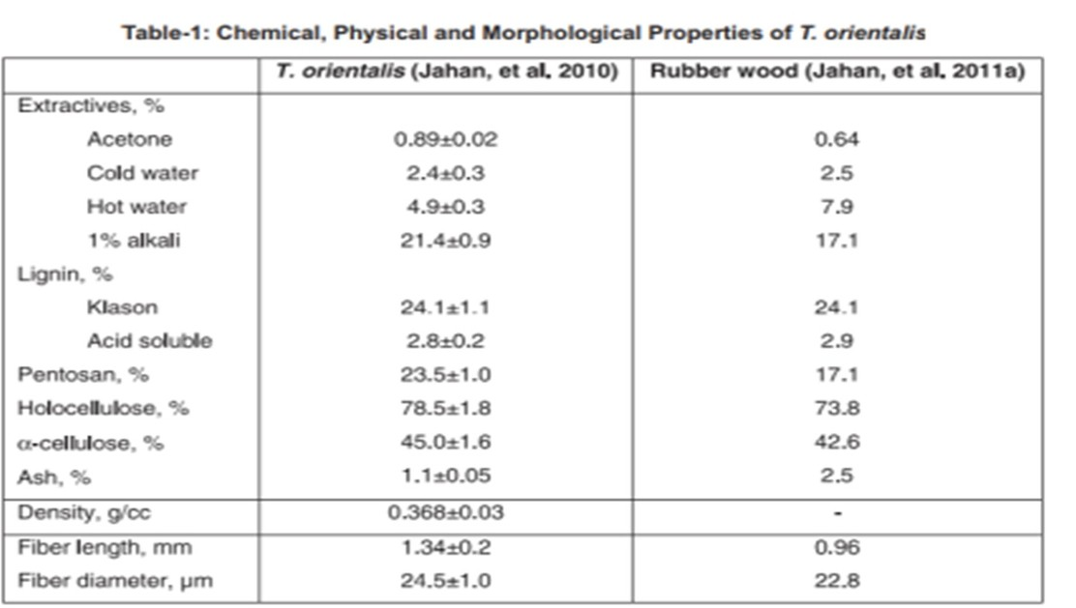
Uses of Inca Whistle
leaves and barks are to treat coughs, sore throats, asthana, bronchitis, gonorrhea,.
antidote to general poisoning
ark infusion is drunk to control blood sugar levels in diabetes mellitus
leaves have showed anti inflammatory, anti arthritic and analgesic activity
Chemical, Morphological and physical Properties Of Trema oriental

Slide 15
Sample Preparation
PREPARATION OF SHEET :
The sheet was prepared using Epoxy resin system ( LY-556 & HY-951 ) & T. oriental
SHEET SPECIFICATION:
Sheet size : ( 12 X 30 ) mm
Weight of sheet : Take from the bottle that we have taken rasin and hardner
plus 100gm
Resin system
: 40% of total sheet weight ( Epoxy resin: 85%=210gm
+ Hardener: 15% = 32gm)
: 4layers
: 15hours (Cold cure)
: 5mm
Layers used Curing time Thickness

Slide 16
Step 3:-Sample kept with water in an enclosed vessel
The sample is kept with water in an enclosed vessel for 2-3 hours.Then heated for around 80deg celcius.
STEP 4: Dipped in sodium hydroxide for 3-4 hrs with water
The sample is then kept in 10% sodium hydroxide solution for 3-4 hours , An important result of the treatment of sodium hydroxide is that it disrupts hydrogen bonds in the structure of the fiber network, so that it can make the fiber surface more rough.
STEP 5: Sample is Dried up
Drying of sample in done without direct contact of sunlight.
Thus our final T.orientalfibre sample is ready for making ropes and composites.
12

Slide 17
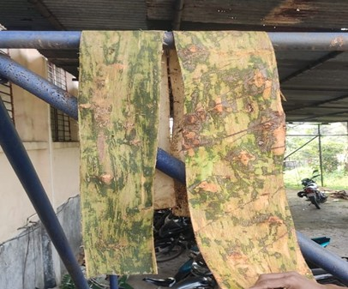
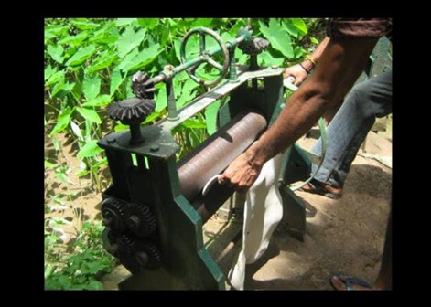
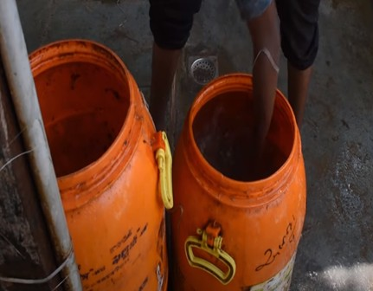
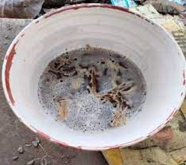
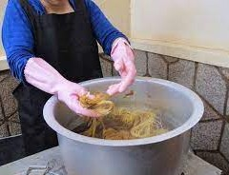
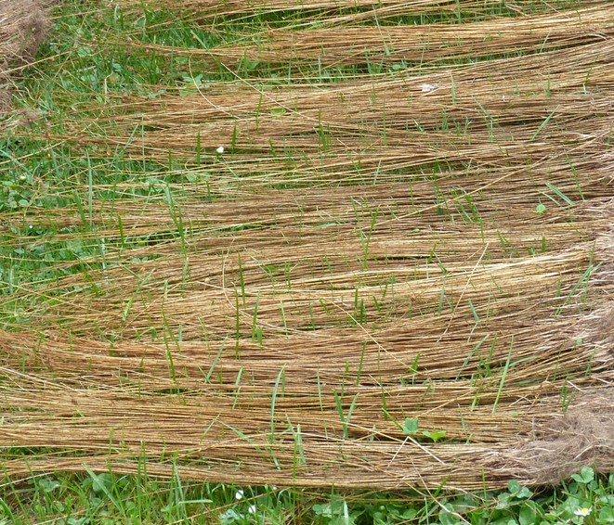
STEP 1
STEP 2
STEP 3
STEP 3
STEP 4
STEP 5
12

Slide 18
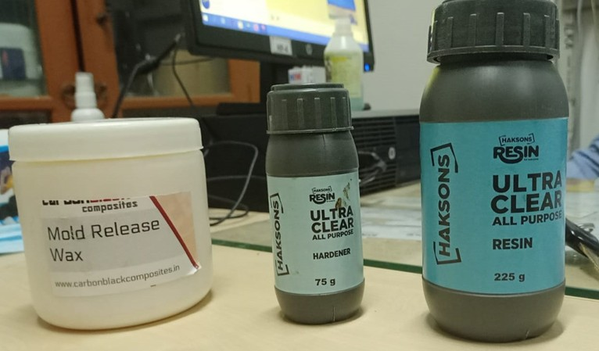
Materials and Method
Material Used for composite
Epoxy resin (LY-556) Hardener(HY-951)
Natural Fibers (T.ORIENTAL) NaOH Solution

Slide 19
2. Hardener (HY-951)
Hardener is a curing agent for epoxy or fiberglass. Epoxy resin requires a hardener to initiate curing; it is also called as catalyst, the substance that hardens the adhesive when mixed with resin. It is the specific selection and combination of the epoxy and hardener components that determines the final characteristics and suitability of the epoxy coating for given environmentt
3. NaOH Solution
Sodium Hydroxide(NaOH) is a alkaline solution used to enhance the surface morphology of natural fibers.
9

Slide 20
1. Epoxy resin (LY-556)
Features of Epoxy
Light weight
Resists most alkalis and acids Resists stress cracking
Retains stiffness and flexibility Low moisture absorption
Non-staining Easily fabricated
Applications of Epoxy
Structural applications
Industrial tooling and composites vElectrical system and electronics
9

Slide 21
Step 3: Availability of Natural fiber TREMA ORIENTALE
in our NIT Agartala college campus
Step 4: Surface treatment of fibers
The fibers were left to treat with 10% NaOH for 3-4 hrs. Later they were drawn and dried under sunlight for 1-2 hours
Step 5: Wet Hand lay-up technique
Hand lay-up technique is the simplest method of composite processing. The infrastructural requirement for this method is also minimal. The processing steps are quite simple. First of all, a release gel is sprayed on the mold surface to avoid the sticking of polymer to the surface. Thin plastic sheets are used at the top and bottom of the mold plate to get good surface finish of the product. Reinforcement in the form of woven mats or chopped strand mats are cut as per the mold size and placed at the surface of mold after perspex sheet. Then thermosetting polymer in liquid form is mixed thoroughly in suitable proportion with a prescribed hardner (curing agent) and poured onto the surface of mat already placed in the mold.
9

Slide 22
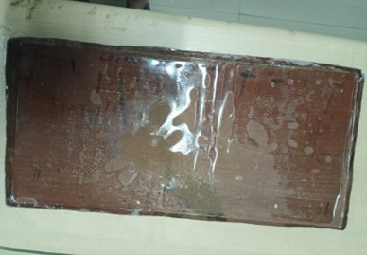
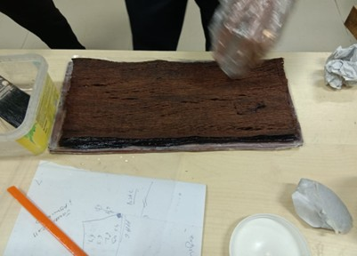
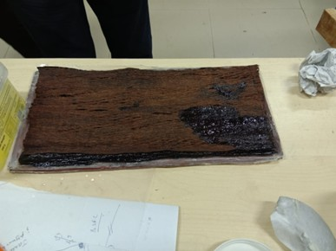
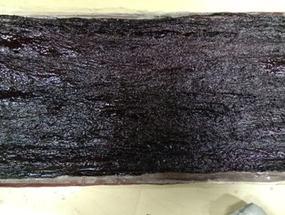
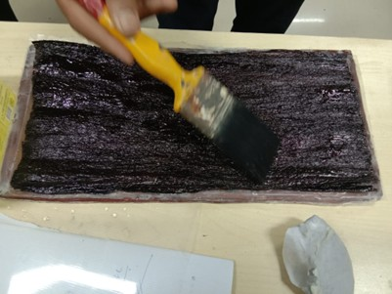
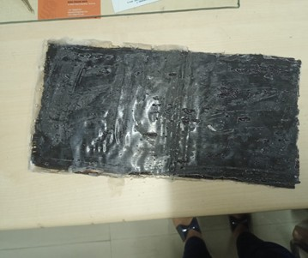
STEP 2
STEP 1
STEP3
STEP 4
STEP 5
FINAL PRODUCT
7

Slide 23
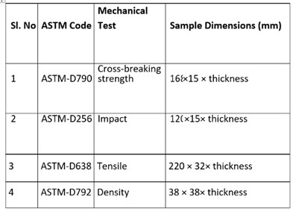




Testing
Specimen preparation as per ASTM standards
The samples are cut to the following dimensions as per ASTM standards for testing shown in
Samples for mechanical testing
7

Slide 24
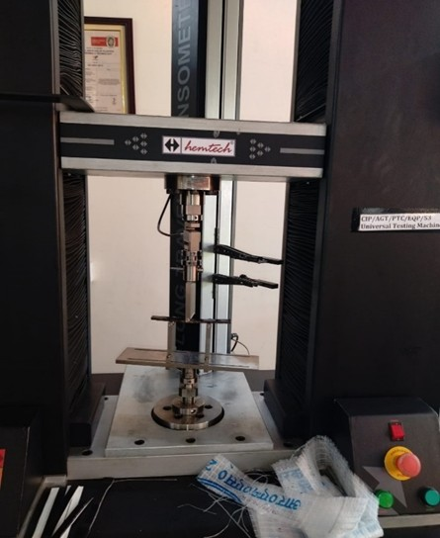
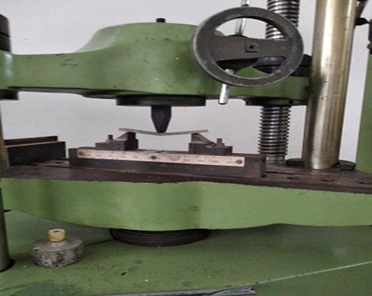
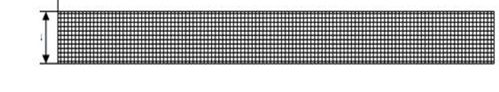
Flexural Testing of Composites
The ability of the material to withstand bending forces applied perpendicular to its longitudinal axis.
Flexutal test specimen
Flexural strength testing machine
Test set up for three point bending tests
7

Slide 25
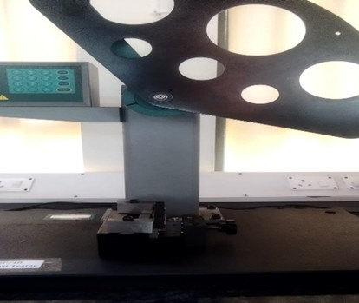
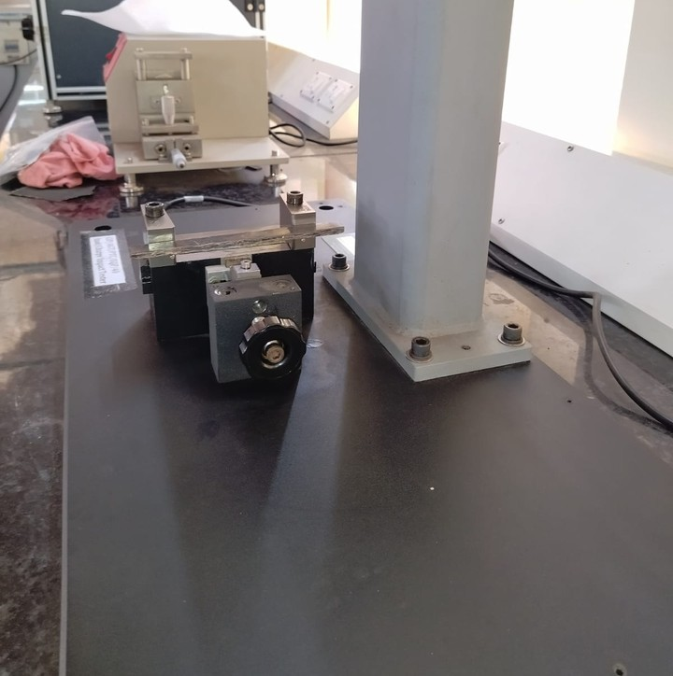
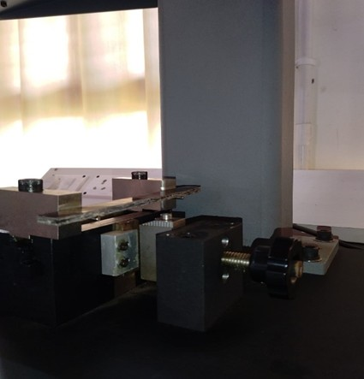
Impact Strength Testing of Composites
CHARPY V-NOTCH TEST
The impact strength of a material is defined as its capability to resist a sudden applied load or force.
7
Plastic impact tester

Slide 26
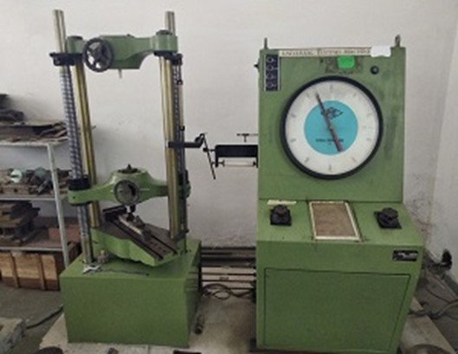
Tensile Strength Testing of Composites:
Tensile strength is defined as the ability of the material to be withstand tensile force when pulled apart. It is expressed in kg/cm2.
Universal Testing Machine
7

Slide 27
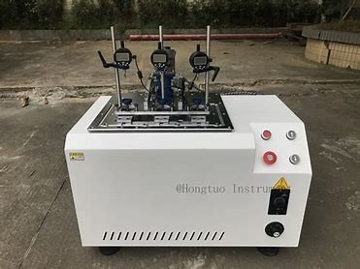
Heat Deflection Temperature Test for composites
HDT is defined as the temperature at which a standard test bar deflects a specified distance under a load. This test is used to determine a material's short-term heat resistance, helping to distinguish between those that can sustain light loads at high temperatures and those that quickly lose rigidity over a narrow temperature range.
7

Slide 28
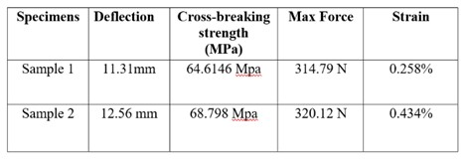
Flexural Test Results
The following tables provides the details of the Flexural test results obtained for various combinations of epoxy resin system + trema orientalis
7

Slide 29
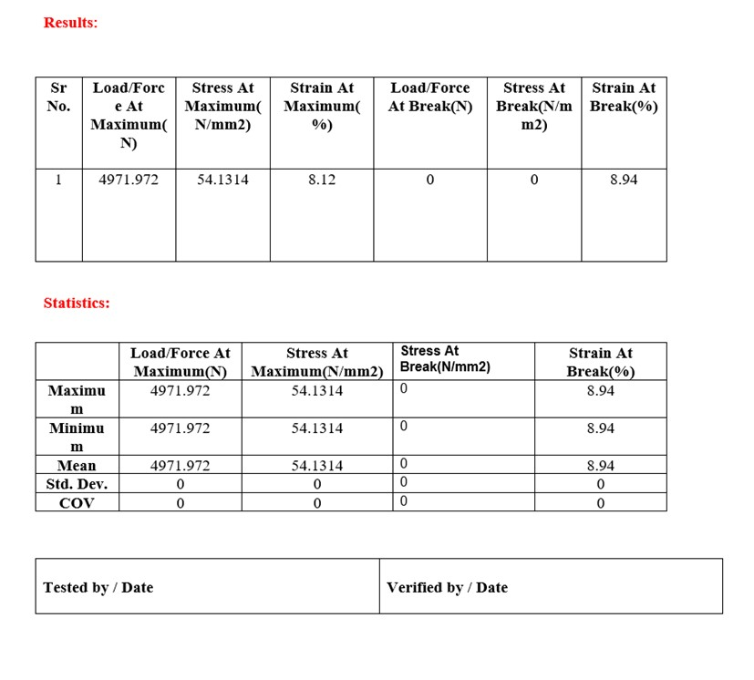
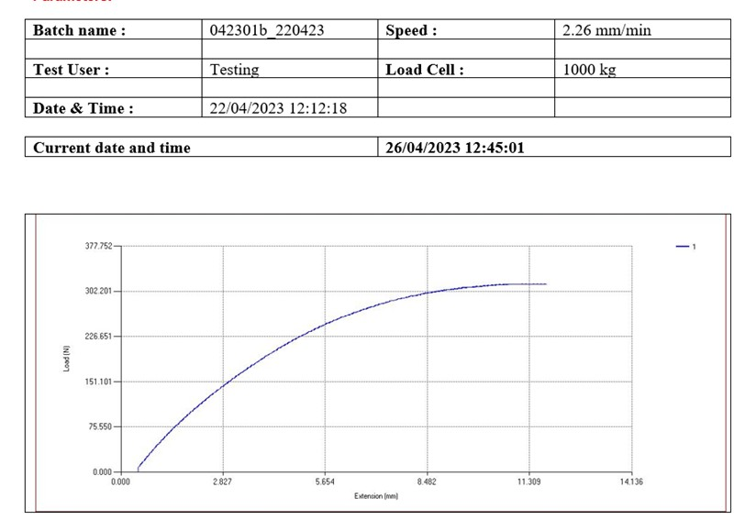
7

Slide 30
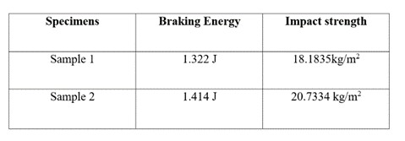
Impact Test Results
The following tables provides the details of the Impact test results obtained for various combinations of epoxy resin sytem + Trema Orientalis
7

Slide 31
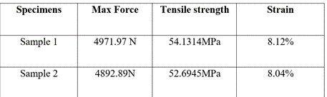
Tensile Test Results
The following tables provides the details of the tensile test results obtained for various combinations of epoxy resin sytem + Trema Orientalis

Slide 32
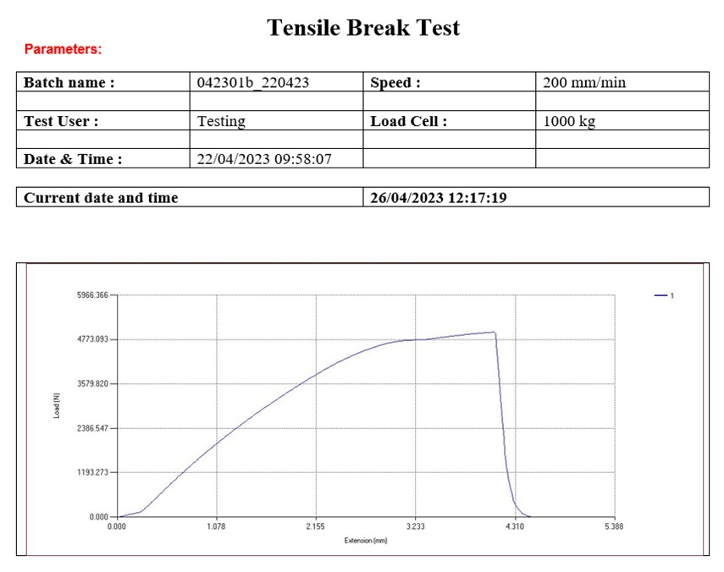
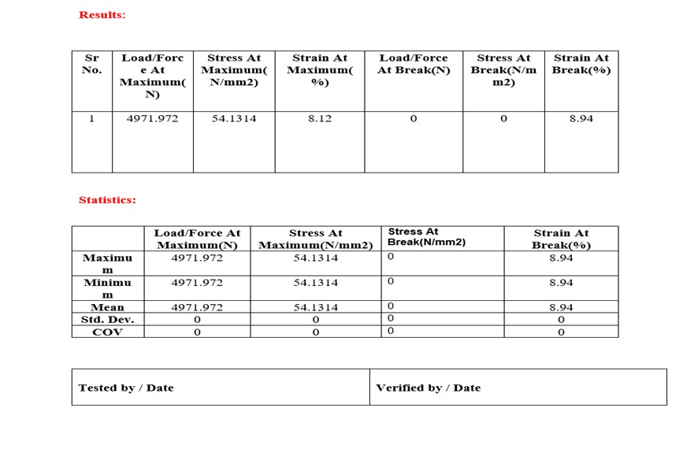
7

Slide 33
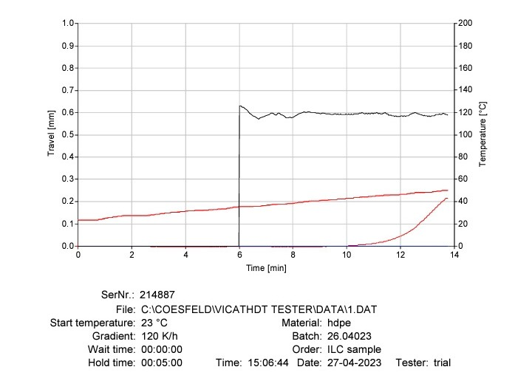
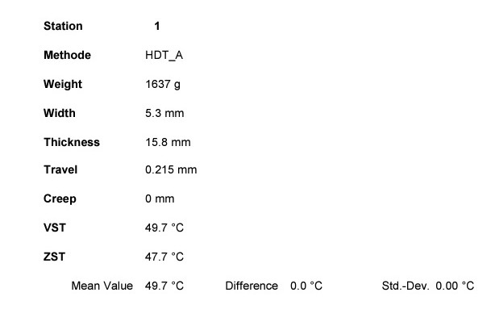
Heat Deflecftion temperature Test results
7

Slide 34
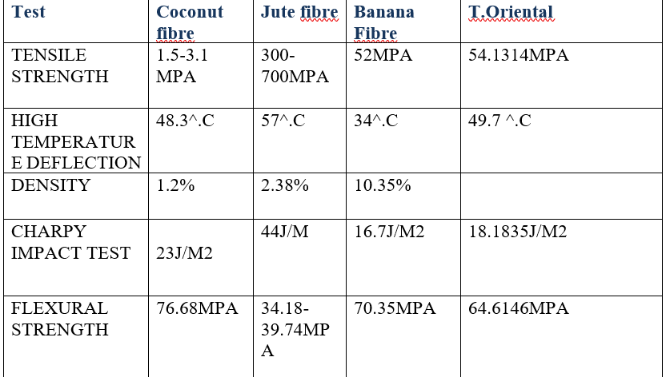
Comparison between Jute fibre, Core Fibre, Banana Fibre and Trema oriental fibre
7

Slide 35
Scope of Future Improvement
Marine application:-The first marine application of composite material that is fiber reinforced polymer (FRP) in construction of boat nearly after World War II.
Aerospace application:-Replacing heavier material with better strength and resisting power.
Reduces fuel consumption.
Interior of aerospace are made of compositr material which provides better look, makes efficient and long lasting.
Automobile Application:-automobile companies use the carbon fiber to manufacture high performance vehicle.
Various parts of automobile are made-up with the composite material. Such as seats, body parts, steering wheel, valve mechanism parts, fuel tanks, bumpers, carpeting, lighting, insulation, roof assembly etc
7

Slide 36
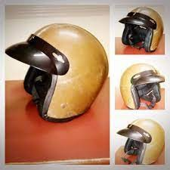
Our Ultimate Goal is to make a simple helmet by using this hybrid composite.
7

Slide 37
THANK YOU
7

